Slide 1

Getting started…
Please sit in rows A through J only
Form groups of 3-5 students
Discuss: what are you most confused about?
Post questions on Ask For Me!

Slide 2
This week
Confidence intervals & hypothesis testing
What it means to reject the null model
Power and Type II error
Replication
Sampling distribution of PRE and F

Slide 3
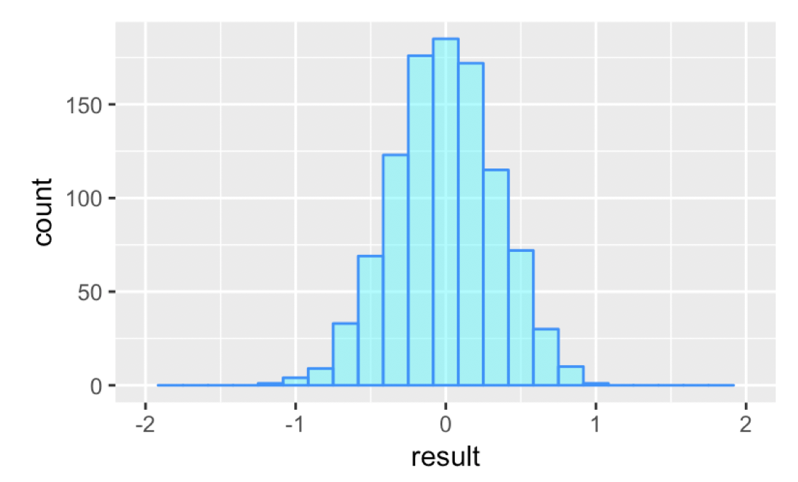
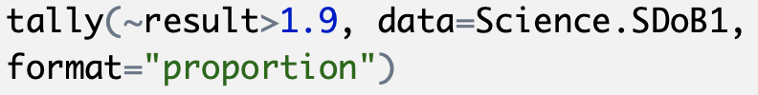
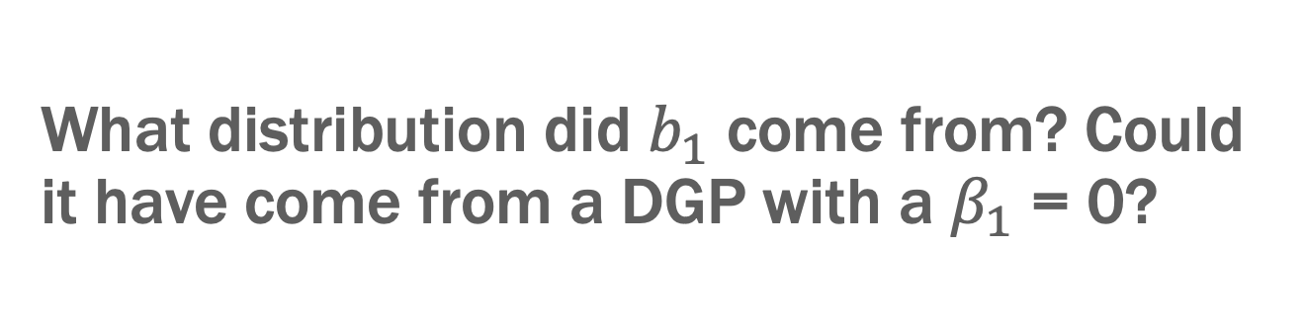
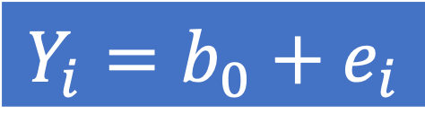
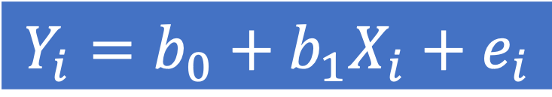
What distribution did $b_{1}$ come from? Could it have come from a DGP with a $β_{1}$ = 0?
$$Y_{i}=b_{0}+b_{1}X_{i}+e_{i}$$
$$Y_{i}=b_{0}+e_{i}$$
p=.000
Sampling distribution for the empty model

Slide 4
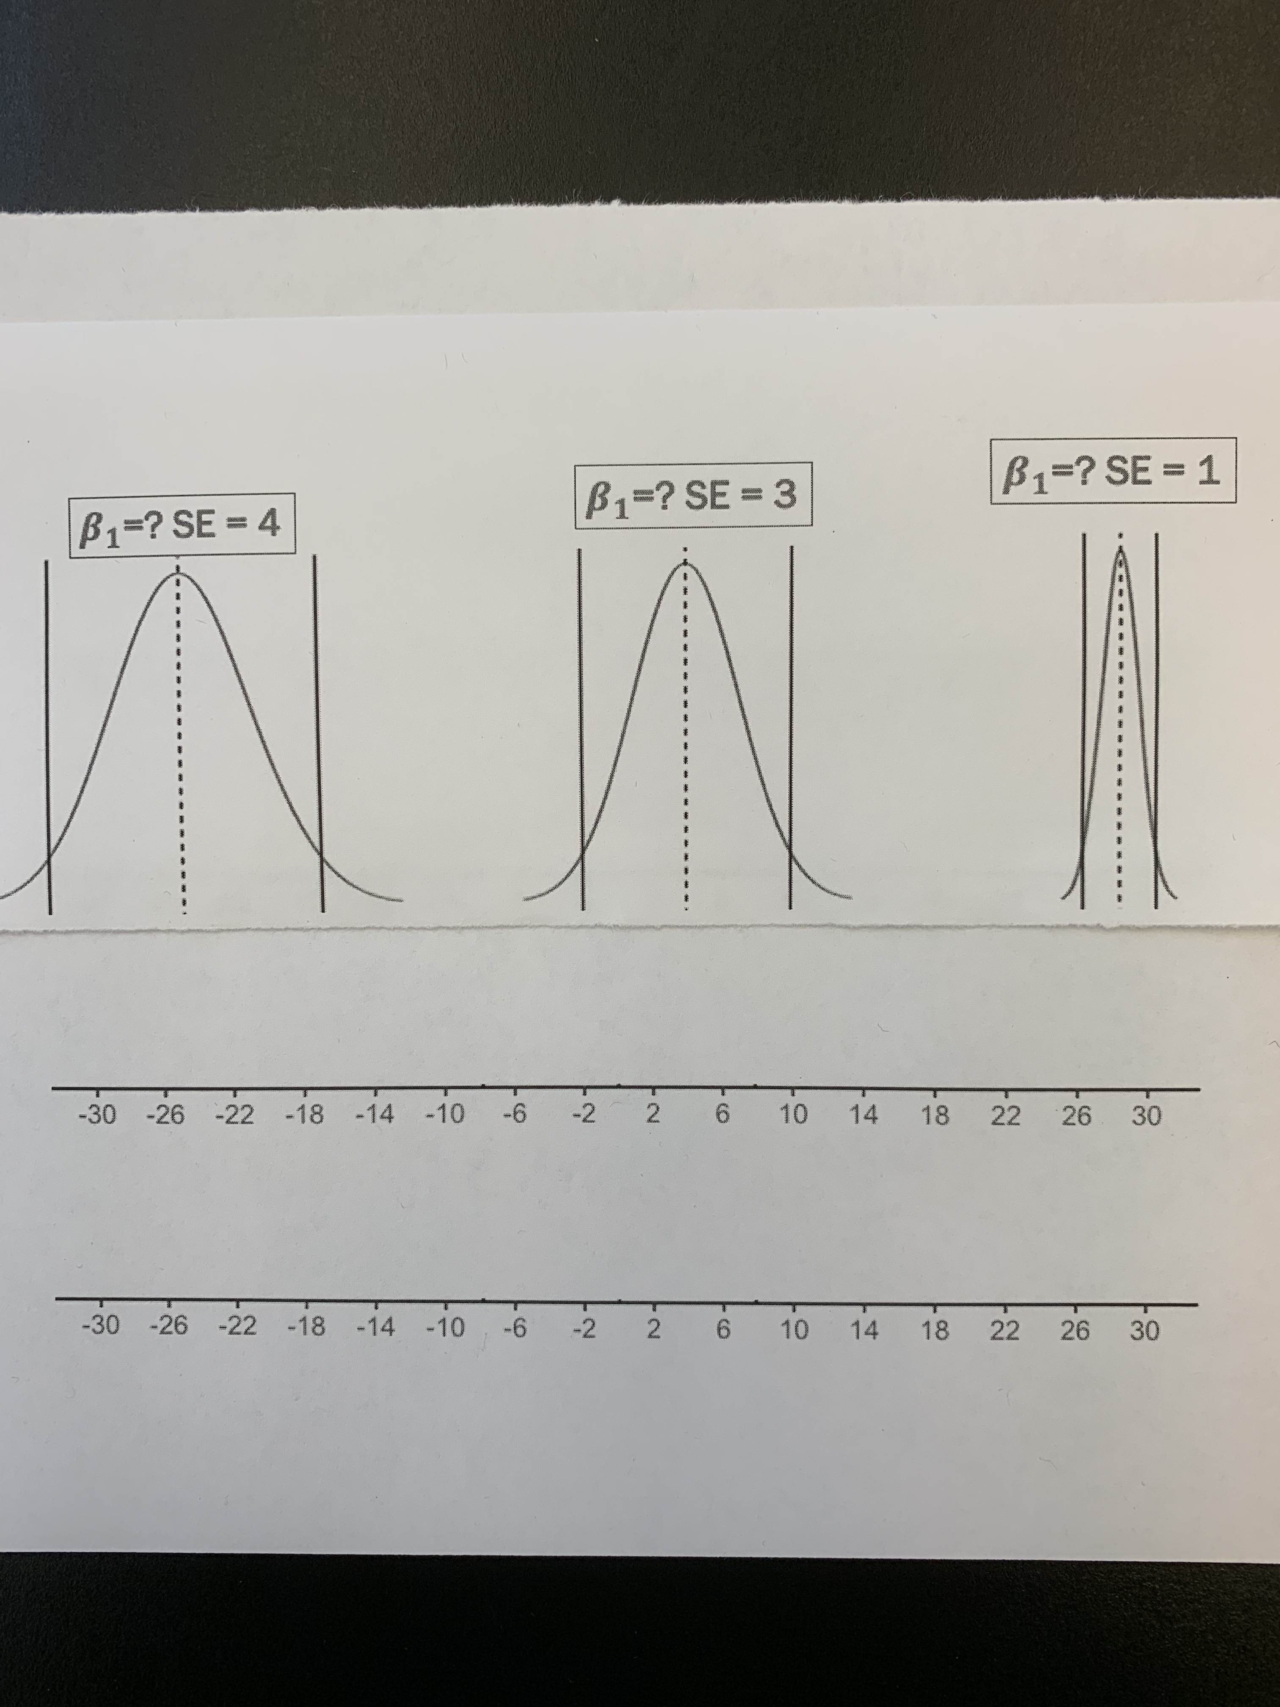
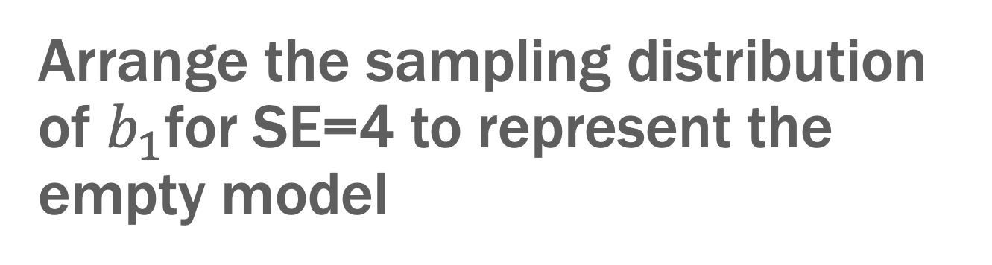
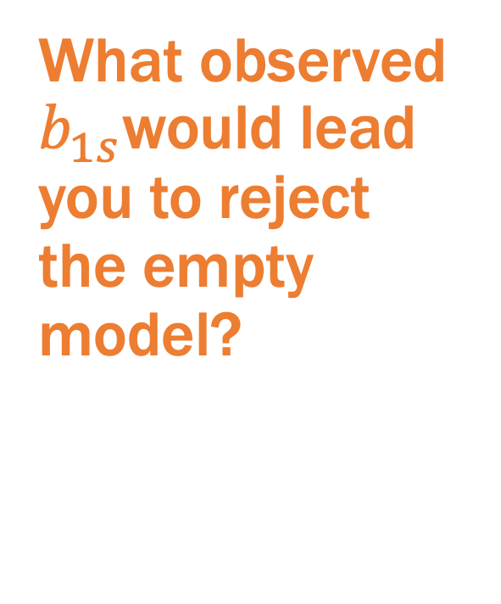
Arrange the sampling distribution of $b_{1}$for SE=4 to represent the empty model
What observed $b_{1s}$would lead you to reject the empty model?

Slide 5
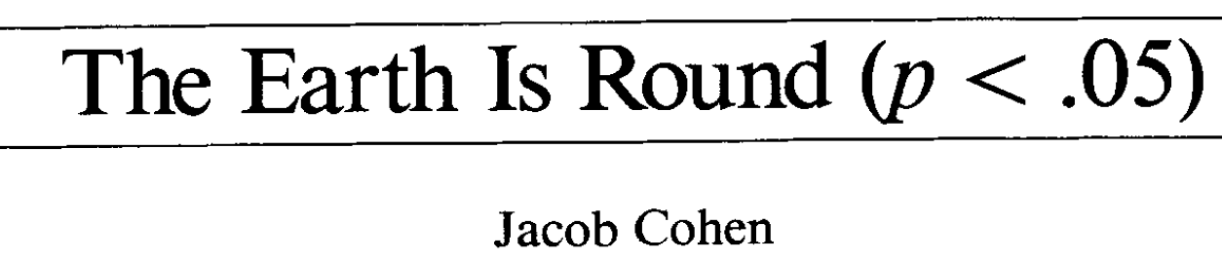

Discuss
The null model can always be rejected if the sample size is large enough.

Slide 6
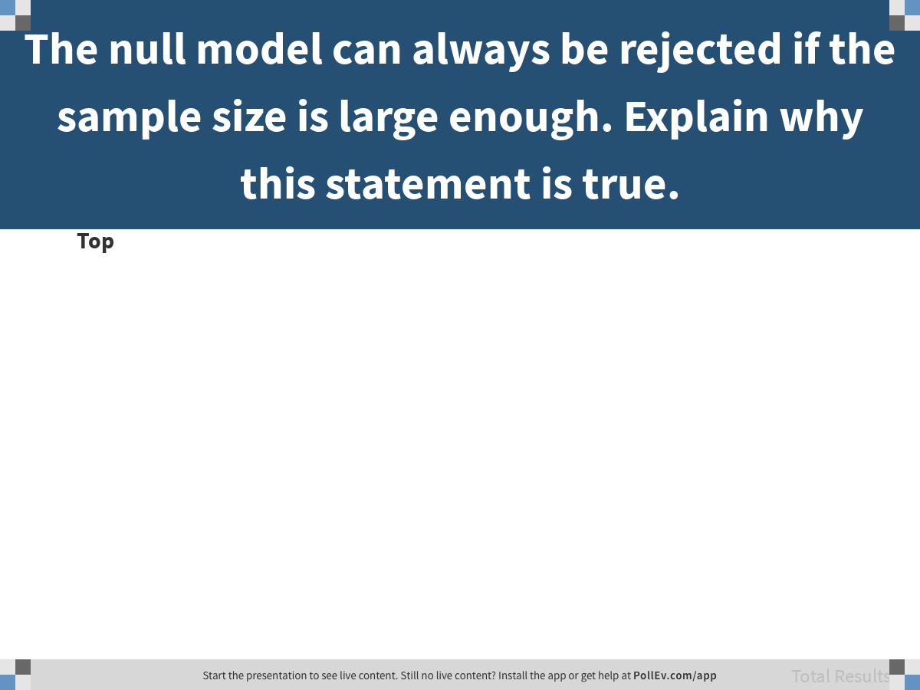
Notes:
The null model can always be rejected if the sample size is large enough. Explain why this statement is true.
https://www.polleverywhere.com/discourses/I8eXnVrAjUTYImZmo1dhN

Slide 7
Power and Type II Error

Slide 8
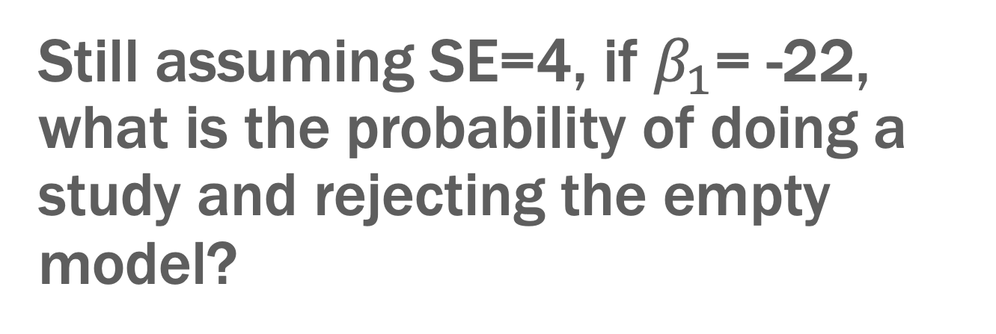
Still assuming SE=4, if $β_{1}$= -22, what is the probability of doing a study and rejecting the empty model?
If we do the study again, what is the probability?
What is chance of mistakenly not rejecting null (Type II error)?

Slide 9

Still assuming SE=4, if $β_{1}$= -16, what is the probability of doing a study and rejecting the empty model?
If we do the study again, what is the probability?
What is chance of mistakenly not rejecting null (Type II error)?

Slide 10
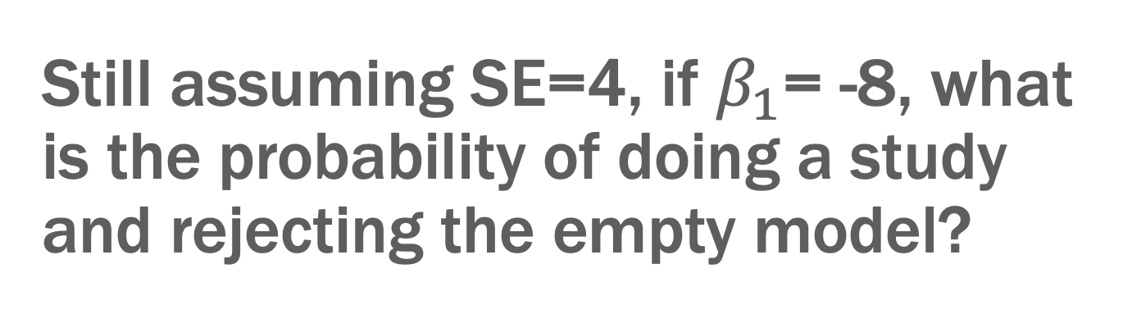
Still assuming SE=4, if $β_{1}$= -8, what is the probability of doing a study and rejecting the empty model?
If we do the study again, what is the probability?
What is chance of mistakenly not rejecting null (Type II error)?

Slide 11
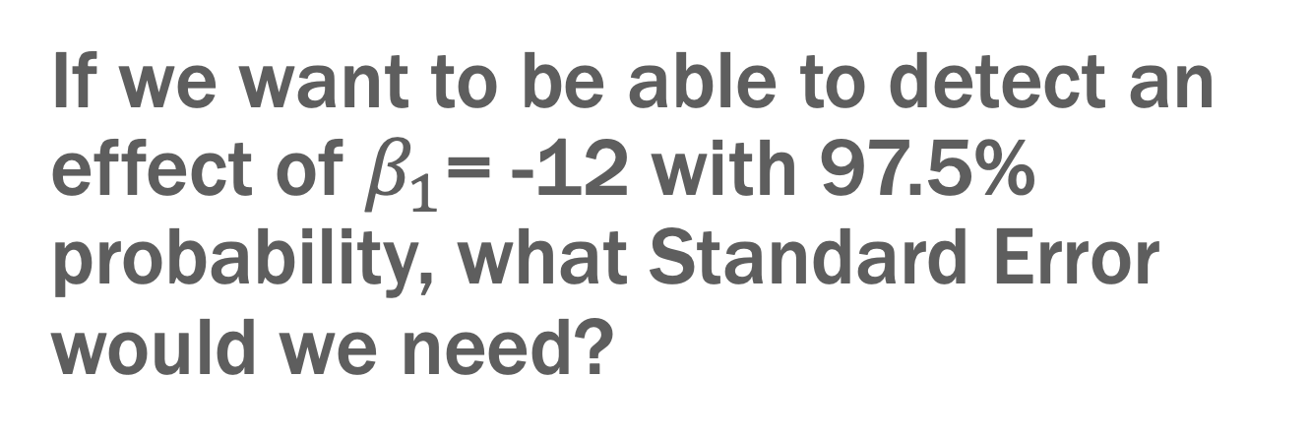
If we want to be able to detect an effect of $β_{1}$= -12 with 97.5% probability, what Standard Error would we need?
Try various Standard Errors
*HINT: make sure to adjust both null and assumed effect distributions

Slide 12
Power + Type II Error = 1.0

Slide 13
Mueller & Dweck (1998)

Slide 14
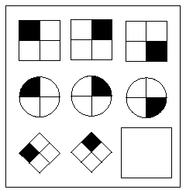
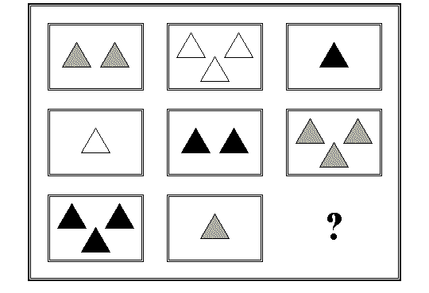
Raven’s Progressive Matrices
What fits in the missing space to complete the pattern?

Slide 15
Mueller & Dweck (1998) – 5th graders
Feedback: "Wow, you did very well on these problems. You got [number of problems] right. That's a really high score."
Control condition: Nothing else
Effort condition: “"You must have worked hard at these problems."
Intelligence condition: “You must be smart at these problems."
3 Randomly Assigned FEEDBACK Groups
FEEDBACK Delivered Here
Easy Set
Difficult Set
New Easy Set
PS1
PS2
PS3
PSDIFF

Slide 16
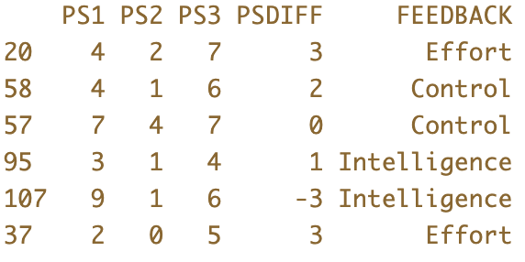
What outcomes might we be interested in?
Why might PSDIFF be a better outcome variable than PS3? (Discuss)

Slide 17
Look at effect of FEEDBACK on PS1 graphically

Slide 18
Write the model for PS1 explained by FEEDBACK using GLM notation.

Slide 19
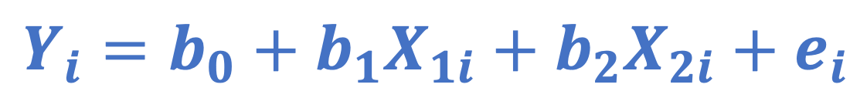
$$Y_{i}=b_{0}+b_{1}X_{1i}+b_{2}X_{2i}+e_{i}$$

Slide 20
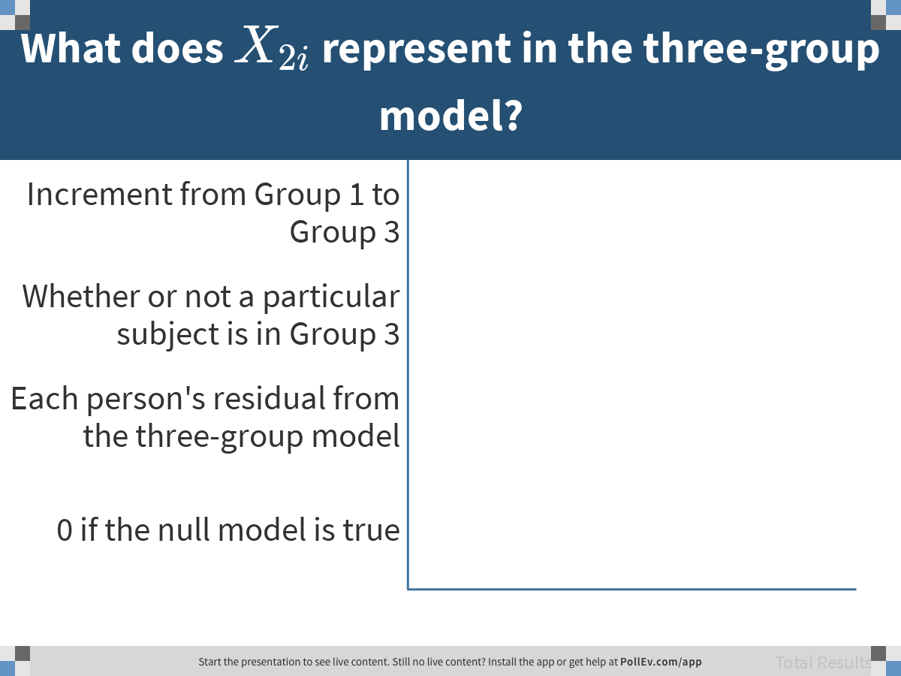
Notes:
What does $$X_{2i}$$ represent in the three-group model?
https://www.polleverywhere.com/multiple_choice_polls/iBdX0EVa4Cd9ndn5cQR11

Slide 21
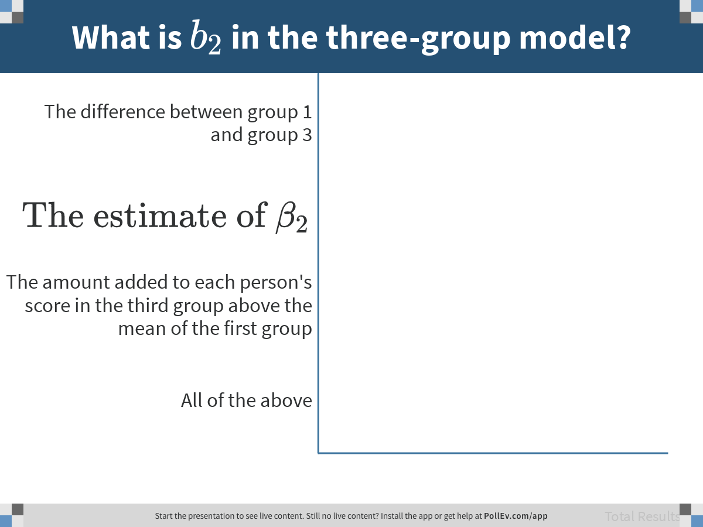
Notes:
What is $$b_2$$ in the three-group model?
https://www.polleverywhere.com/multiple_choice_polls/8fDz5s3qL5rguaTD2rOdy

Slide 22
Fit the model of FEEDBACK on PS1

Slide 23
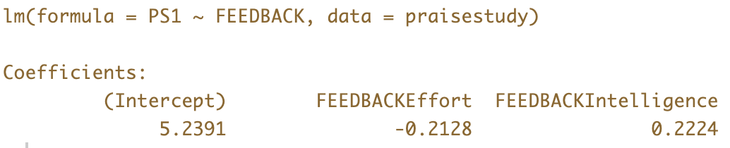
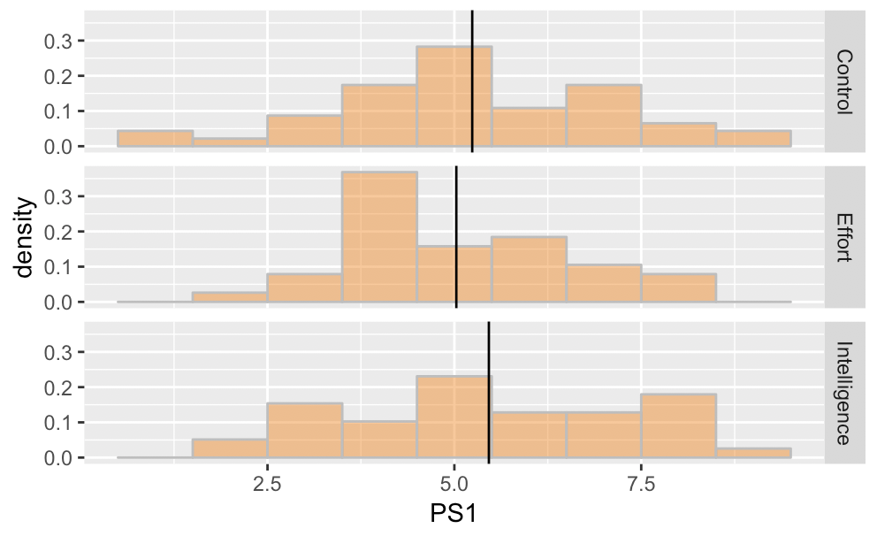
Why is the Effort group solving fewer problems correctly (on average) than the other two groups?

Slide 24
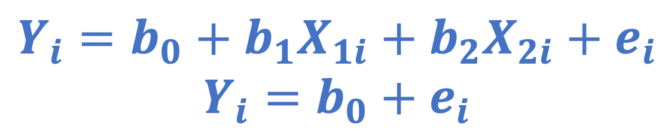
$$Y_{i}=b_{0}+b_{1}X_{1i}+b_{2}X_{2i}+e_{i}$$
$$Y_{i}=b_{0}+e_{i}$$
As the researcher, what are we hoping for in this model comparison?

Slide 25
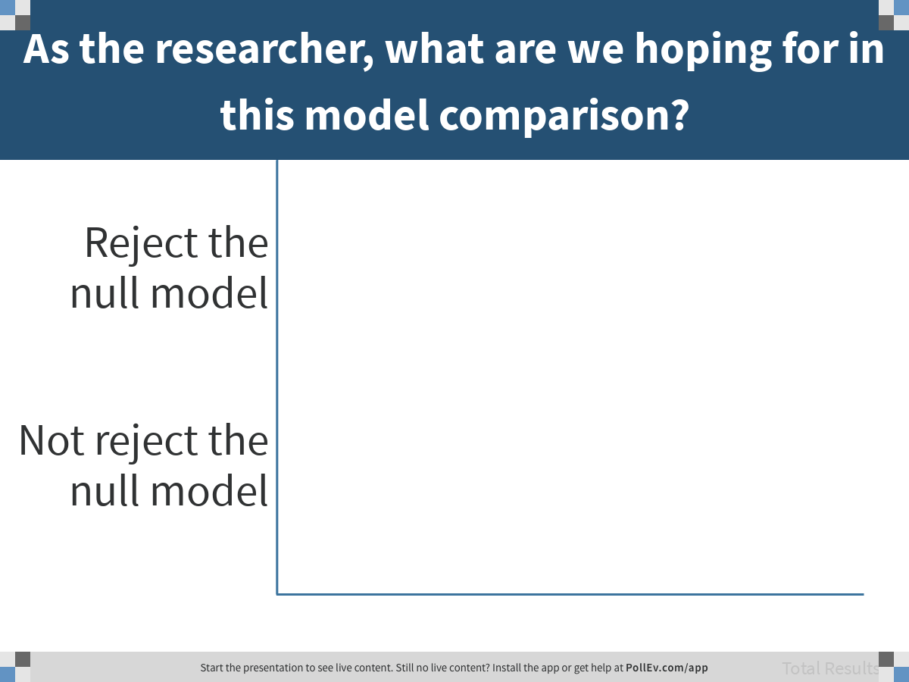
Notes:
As the researcher, what are we hoping for in this model comparison?
https://www.polleverywhere.com/multiple_choice_polls/47AL5oVlPRvsd7yNdU6HX

Slide 26
How well does the feedback model fit the data?

Slide 27
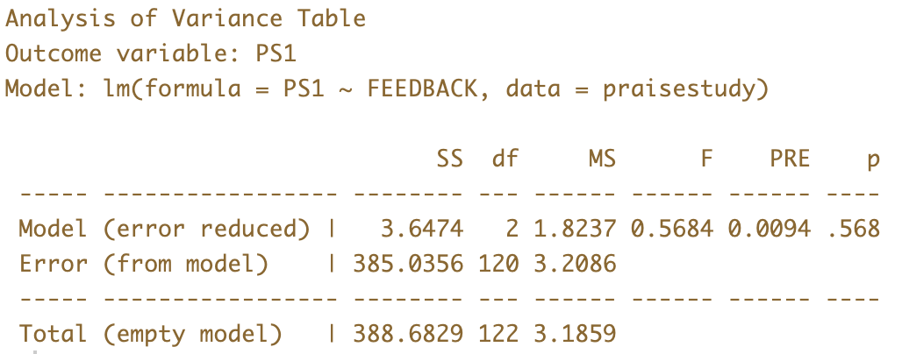
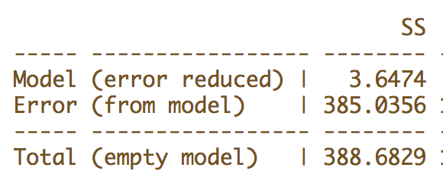
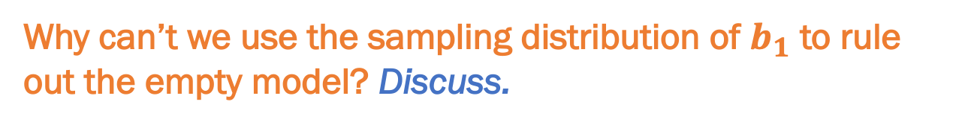
Can we rule out the empty model?
Why can’t we use the sampling distribution of $b_{1}$ to rule out the empty model? Discuss.

Slide 28
If there is no difference between groups (Control=Effort=Intelligence) where would you expect the mean of the sampling distribution of F to be?

Slide 29
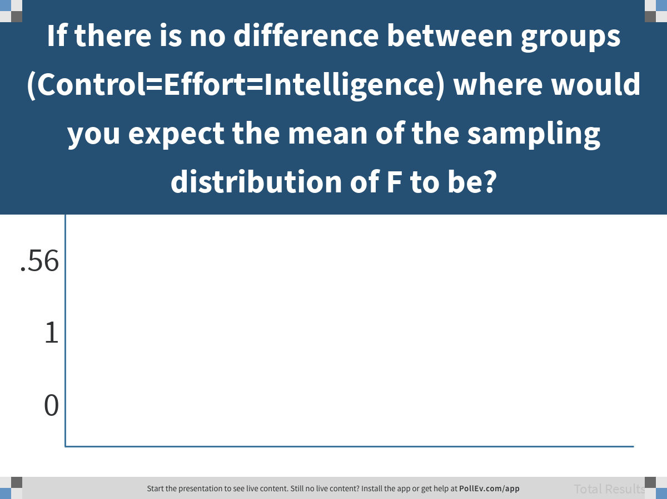
Notes:
If there is no difference between groups (Control=Effort=Intelligence) where would you expect the mean of the sampling distribution of F to be?
https://www.polleverywhere.com/multiple_choice_polls/vCMzYNHAvnfsi49ZWBgpp

Slide 30
Use shuffle to create a sampling distribution of F under the empty model.

Slide 31
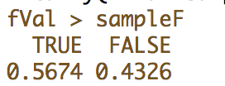
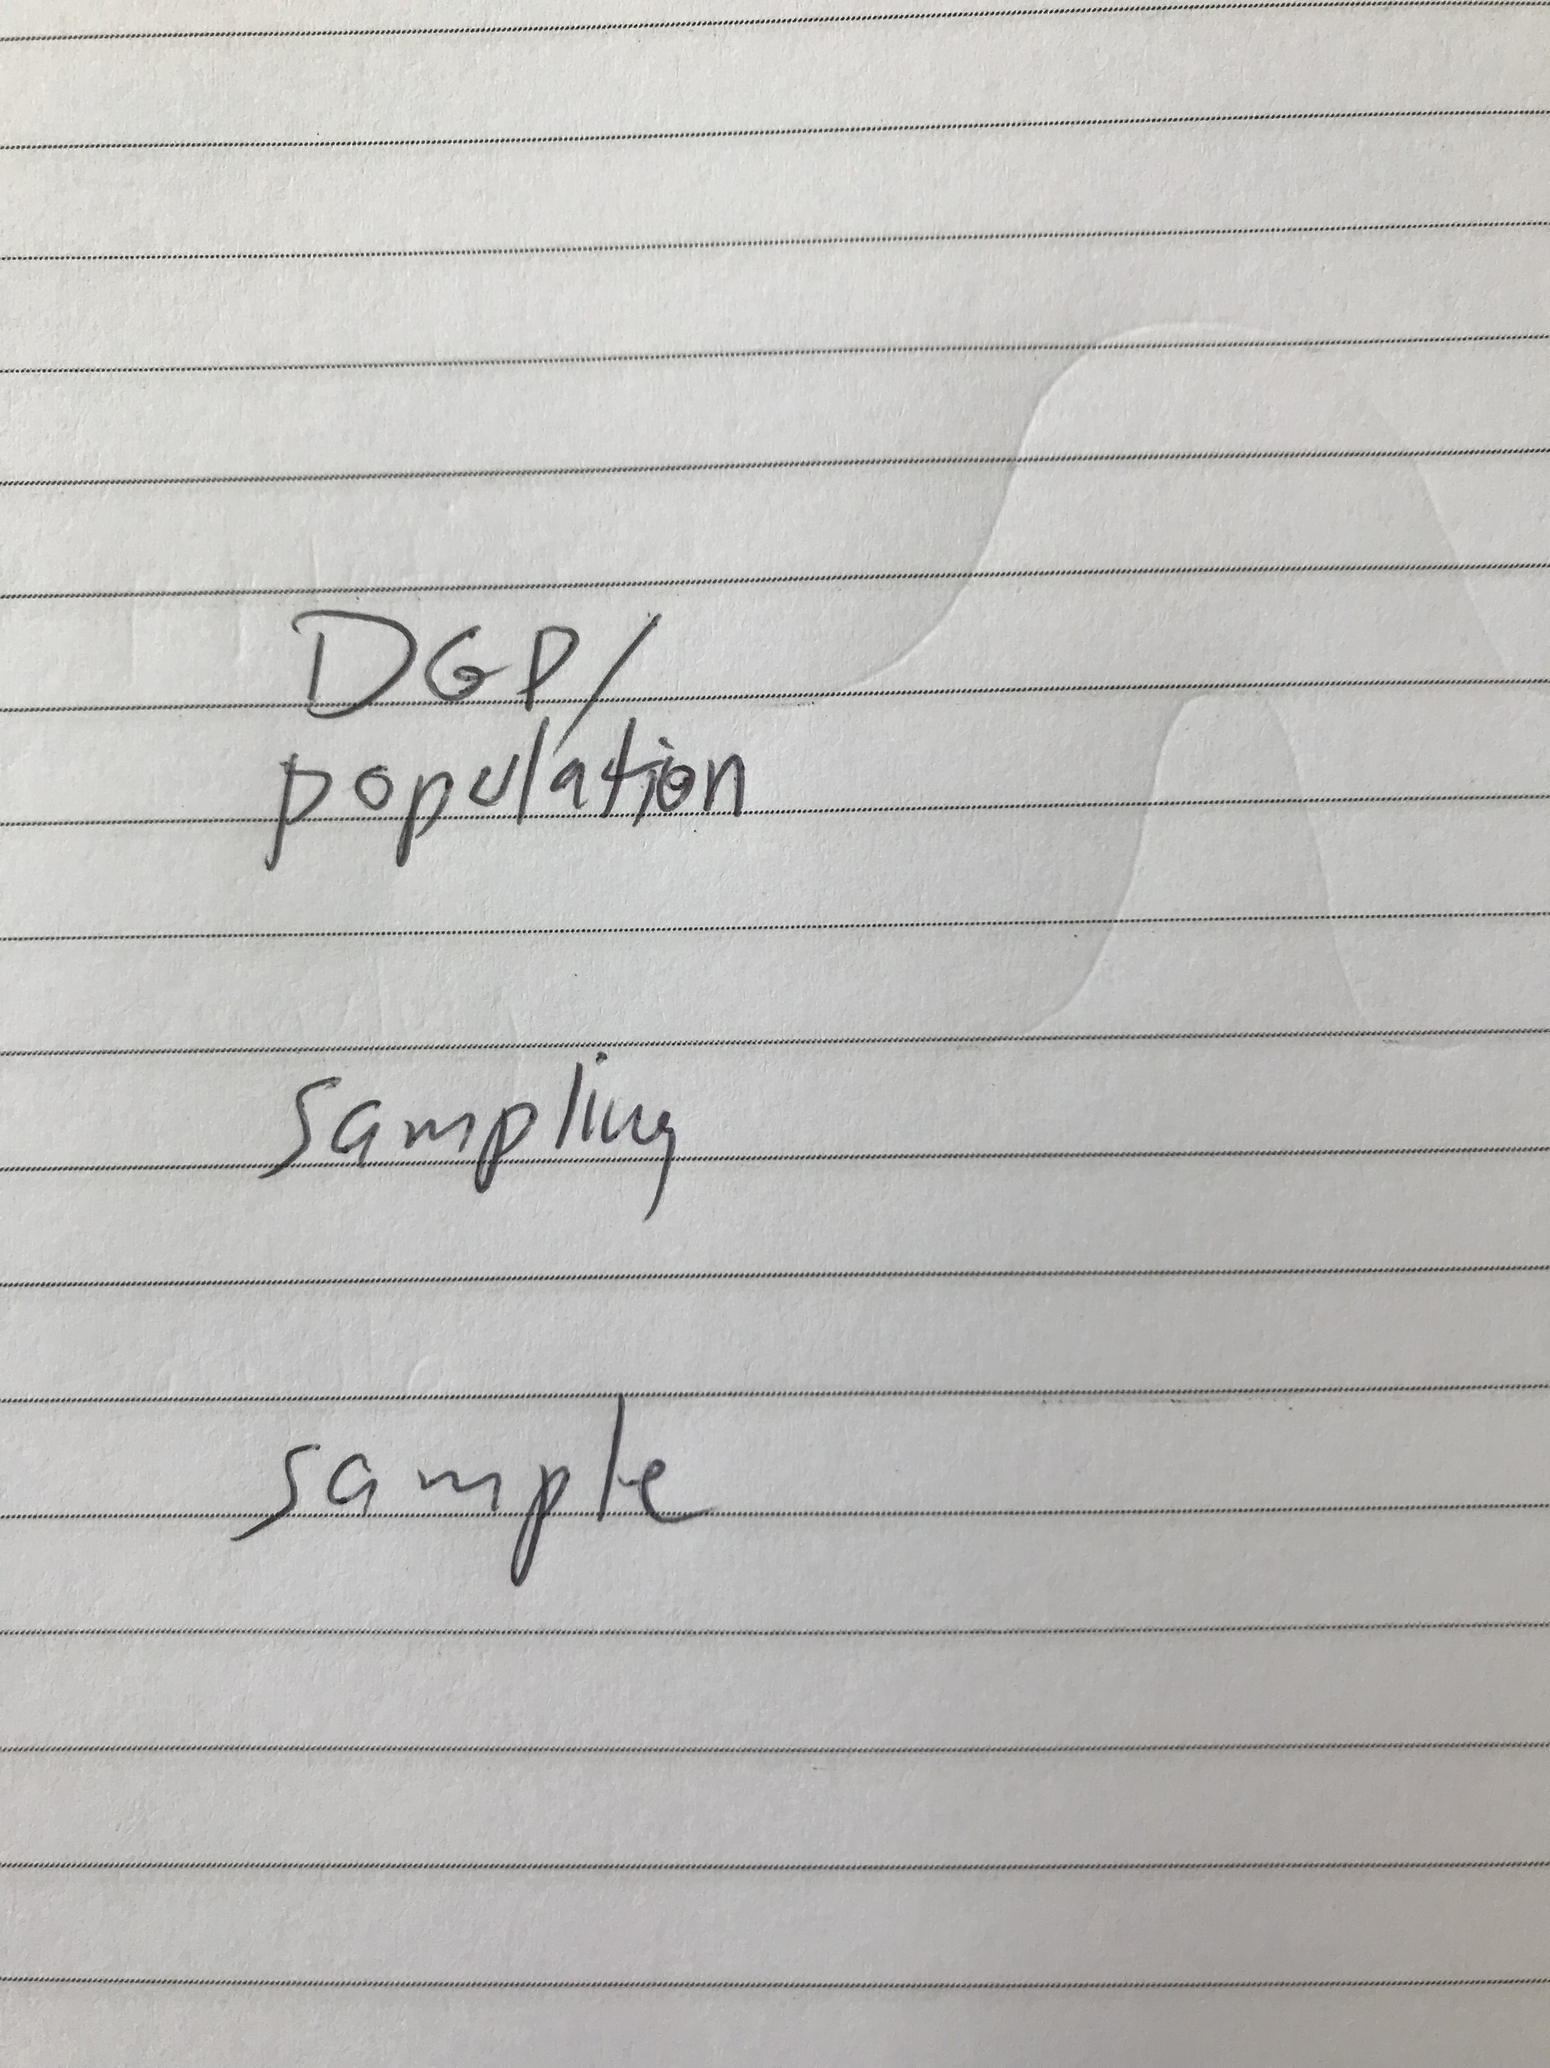
What does this mean? Draw a picture.

Slide 32
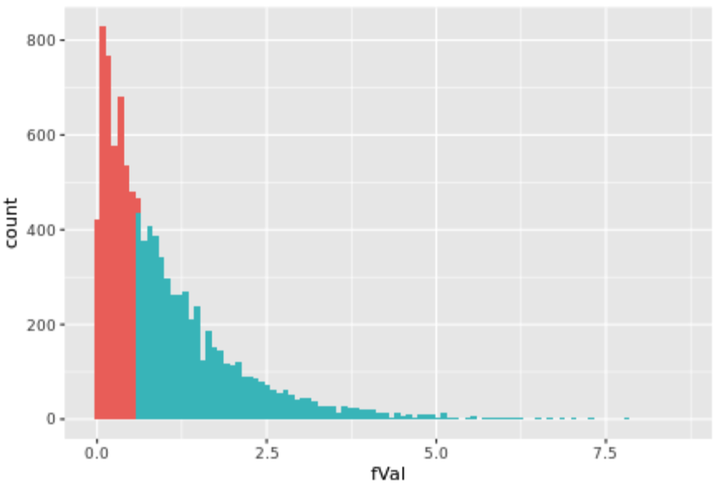
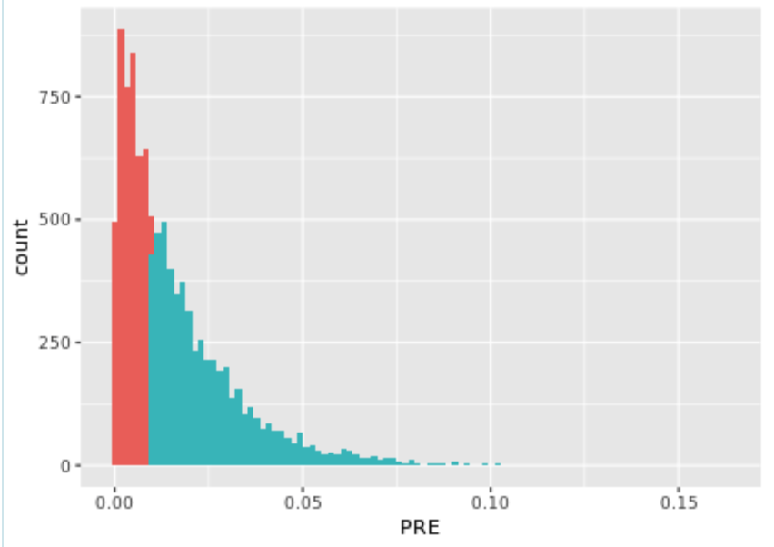
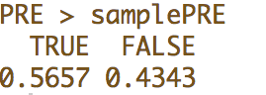
Sampling distribution of F vs. PRE

Slide 33
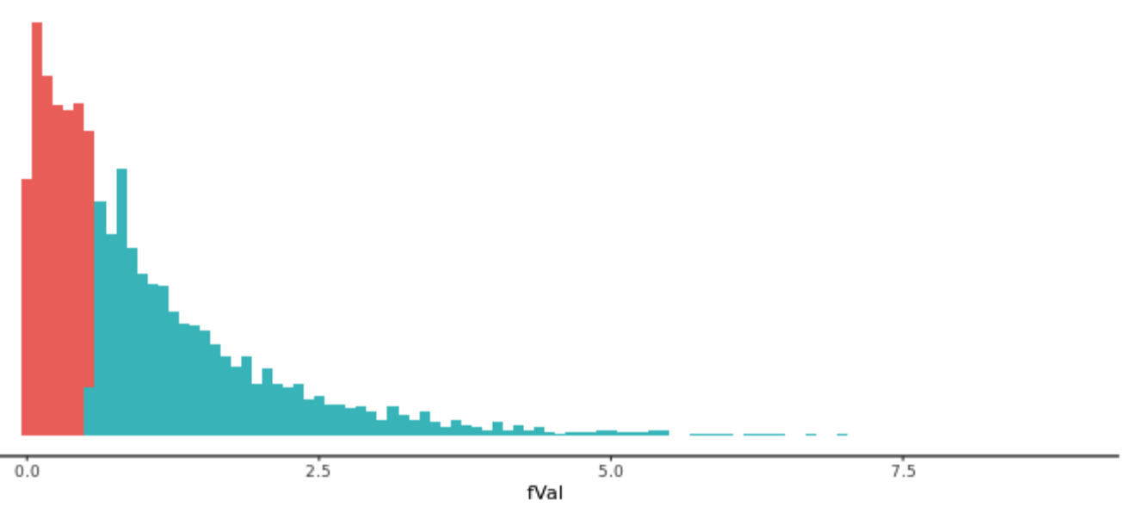
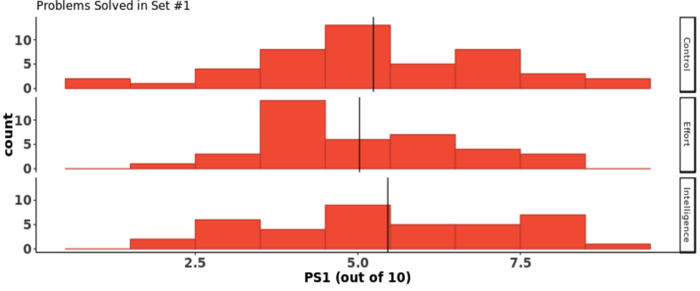
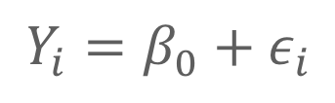
Reflecting on Distribution Triad
Imaginary
Models
Sampling Distribution
Real
Hidden
$$Y_{i}=β_{0}+ε_{i}$$
Population (DGP)
Sample
Distribution
Notes:
What is a statistical model? How does it fit with other psychology models?
We have theories...
But most of them are probabalistic...
A statistical model is a way to
Explain variation
Estimate the parameters of the DGP
Quantify how far off our estimates might be
Rule out chance variation in sampling as an explanation

Slide 34
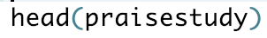
Analysis of PSDIFF
Take the same approach and use it to analyze PSDIFF

Slide 35
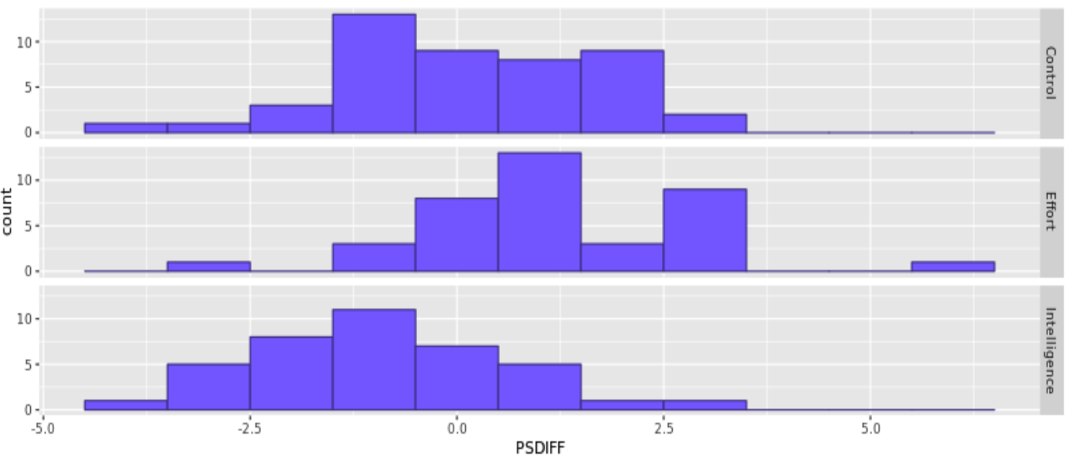
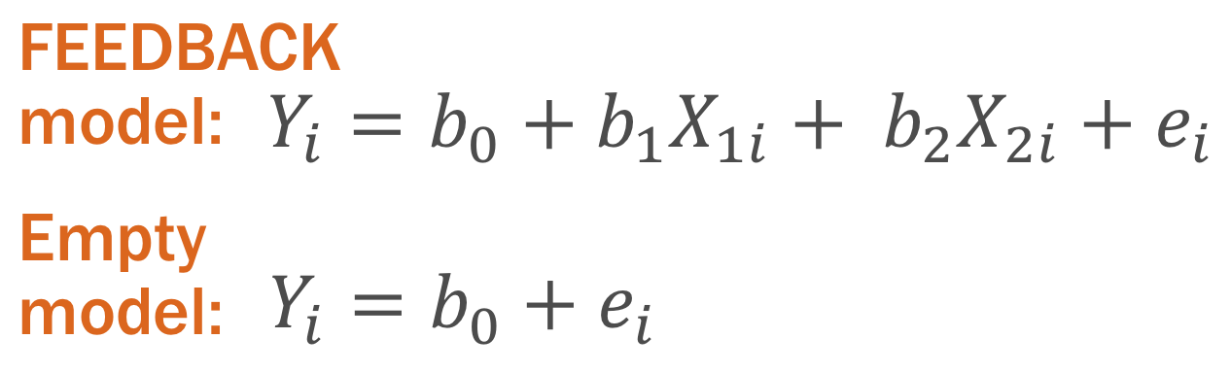
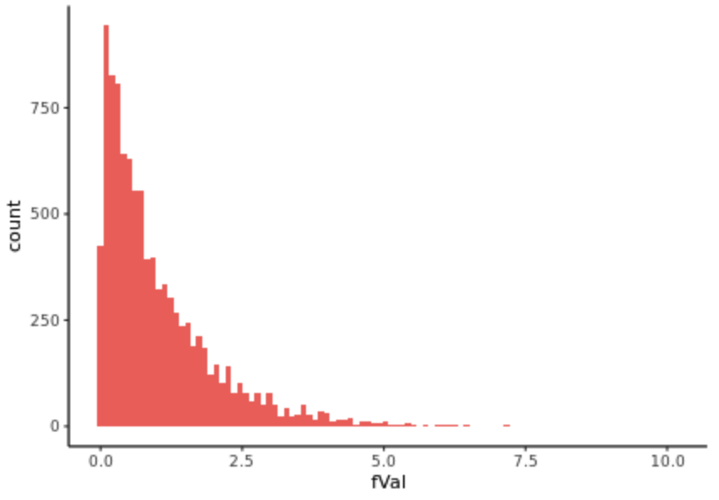
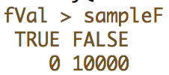
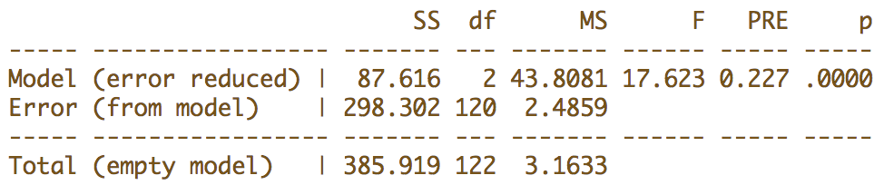
Explore Variation
Model Variation
Evaluate Models
Measurement
Sampling
Design
5th graders, raven’s matrices, 3 sets, experiment, etc
data
Tell Your Story
Make Predictions
Notes:
What’s the story? Is it a cautionary tale about not telling kids that they are smart? Is it an encouragement to praise kids for effort?

Slide 36
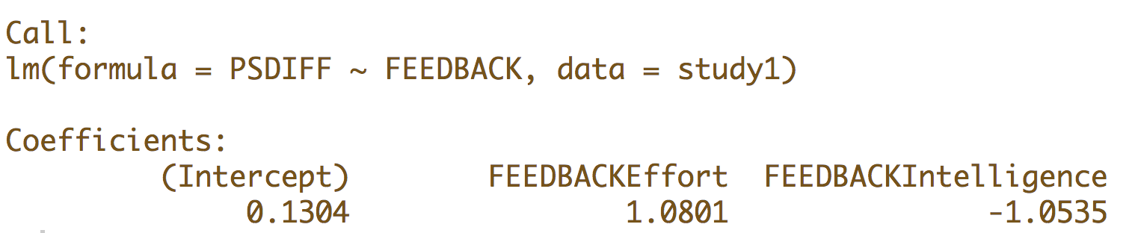
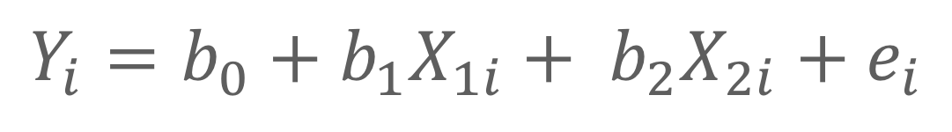
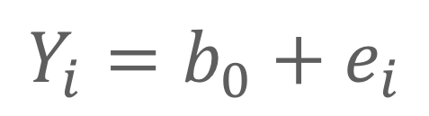
What have we learned by rejecting the Empty Model?
FEEDBACK model:
$$Y_{i}=b_{0}+b_{1}X_{1i}+ b_{2}X_{2i}+e_{i}$$
Empty model:
$$Y_{i}=b_{0}+e_{i}$$

Slide 37
Three Groups: Which group is different from which?
FEEDBACK model:
$$Y_{i}=.13+1.08{Effort}_{i}−1.05{Intell}_{i}+e_{i}$$
Empty model:
$$Y_{i}=b_{0}+e_{i}$$

Slide 38
Data for Mueller & Dweck
Use google doc called Confidence Interval Handout
praisestudy <- read.csv(“https://docs.google.com/spreadsheets/d/e/2PACX-1vSOk22ulsLE8gvsUKDhHHHJuzdNw1CR--ZQupN_DyRYDgbVD36BX00cgY4ZI7YYnVqysh0xKuvplbUQ/pub?output=csv”, header=TRUE)

